Slide 1



VINGROUP (VIC)
Financial Performance Dashboard
Phạm Phước · FAECIU23016 · Midterm Report

Slide 2

VIC DASHBOARD
Introduction
Visualizing Vingroup's Pivot
This project aims to transform raw Vingroup financial data (2015-2025) into a strategic signaling system.
We focus on three dimensions: Snapshots for immediate results, Trends for historical context, and Structures for root-cause analysis.

Slide 3
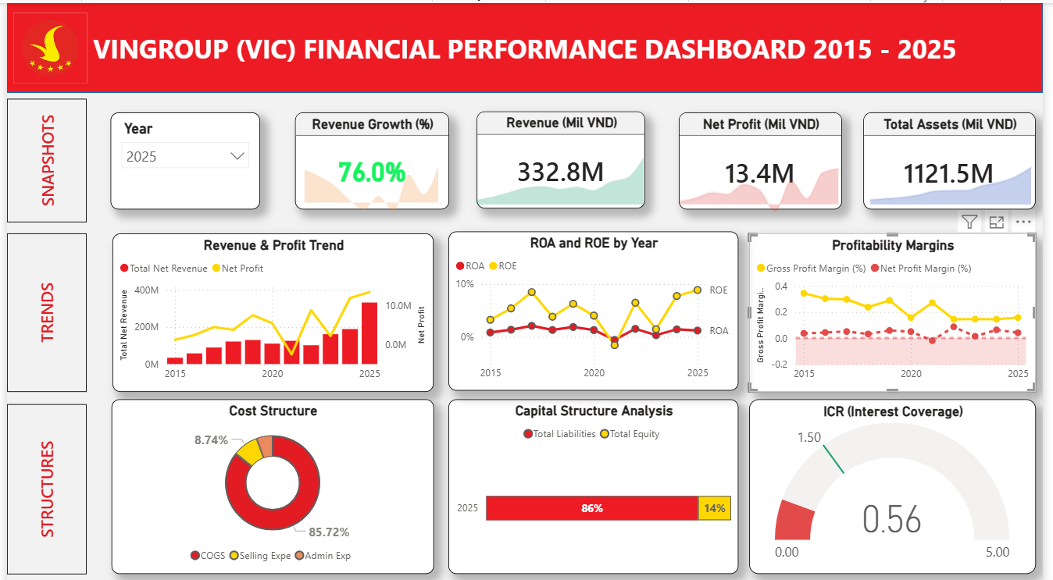
VIC DASHBOARD
Introduction

Slide 4
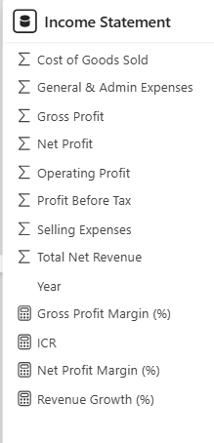
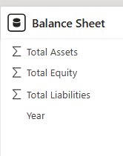

VIC DASHBOARD
Introduction
Relationship between 2 tables

Slide 5
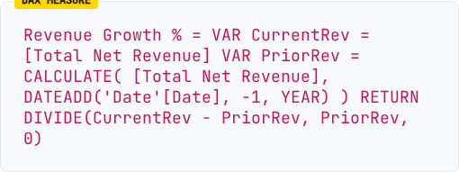
VIC DASHBOARD
DAX Measurement
DAX Measurement
Revenue Growth
Growth metrics must react to Year Slicers instantly. I implemented Time Intelligence DAX to compare current vs. previous periods.
Goal: Transform absolute currency into percentage-based performance indicators.

Slide 6
VIC DASHBOARD
DAX Measurement
DAX Measurement
Net Profit Margin (%)
Net Profit Margin (%) =
DIVIDE (SUM('Income Statement' [Net Profit]), SUM('Income Statement'[Total Net Revenue]))
Technical Logic: Utilizes the DIVIDE function to ensure safe arithmetic handling and SUM for dynamic aggregation across multi-year data
Goal: Standardize profitability metrics across Vingroup's đa dạng industrial segments, from Real Estate to Manufacturing.

Slide 7
VIC DASHBOARD
DAX Measurement
DAX Measurement
Gross Profit Margin (%)
Gross Profit Margin (%) =
DIVIDE (SUM('Income Statement' [Gross Profit]), SUM('Income Statement'[Total Net Revenue]))
Use the DIVIDE command to handle years with zero revenue, avoiding system errors. Use SUM to ensure calculations update instantly based on Year or Entity slicers.
Goal: Measure how much gross profit is retained after covering the Cost of Goods Sold (COGS)

Slide 8
VIC DASHBOARD
DAX Measurement
DAX Measurement
ICR - Interest Coverage Ratio
ICR =
DIVIDE(SUM('Income Statement'[Operating Profit]), ABS(SUM('Income Statement'[Operating Profit]) - SUM('Income Statement'[Profit Before Tax])), 0)
This measure utilizes DIVIDE and ABS functions to safely derive interest coverage by calculating the gap between operating profit and profit before tax.
Goal: It serves as a real-time solvency sensor to provide early warnings regarding Vingroup’s debt-servicing capacity during its capital-intensive expansion phase.

Slide 9
VIC DASHBOARD
DAX Measurement
DAX Measurement
ROE - Return on Equity
ROE =
DIVIDE(SUM('Income Statement'[Net Profit]), SUM('Balance Sheet'[Total Equity]))
This measure uses DIVIDE and SUM to safely link Net Profit and Total Equity without calculation errors. It ensures real-time, dynamic calculations that update instantly based on any selected year or entity slicer.
Goal: To evaluate capital efficiency by measuring how effectively Vingroup utilizes shareholder equity to generate profit across its diversified industrial portfolio.

Slide 10
VIC DASHBOARD
DAX Measurement
DAX Measurement
ROA - Return on Assets
Employs DIVIDE and SUM to safely link Profit with Assets, ensuring error-free, real-time updates across all slicers.
Goal: It evaluates how efficiently Vingroup converts its total asset base into net earnings across its diversified segments.
ROA =
DIVIDE(SUM('Income Statement'[Net Profit]), SUM('Balance Sheet'[Total Assets]))

Slide 11
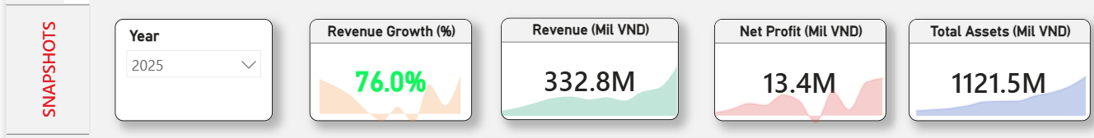
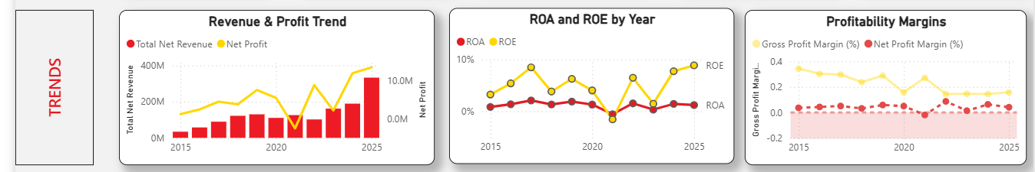
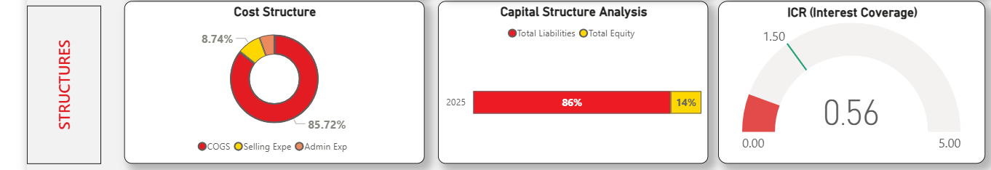
VIC DASHBOARD
Design Strategy
3-Tier Analysis

Slide 12
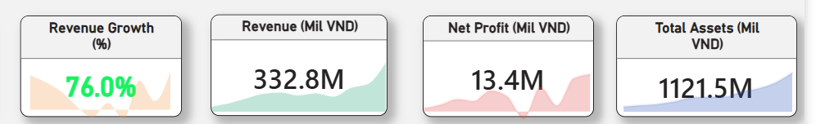
VIC DASHBOARD
Design Strategy
SNAPSHOT
Revenue Growth Indicates a rapid year-over-year expansion in sales. | Revenue Represents the total top-line income and the scale of operations. | Net Profit Reflects actual earnings after all expenses, representing the bottom line. | Total Assets Displays the total value of resources managed by the entity.
Trend Sparklines: The background waves in each card visualize historical fluctuations, providing instant context for each KPI

Slide 13
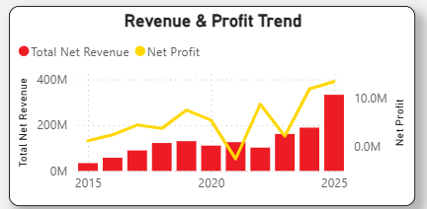
VIC DASHBOARD
Design Strategy
TRENDS
Combo Visualization: Merges Revenue (Bars) and Net Profit (Line) to reveal the direct correlation between operational scale and bottom-line earnings.
Performance Insight: Captures the aggressive revenue expansion post-2020 while monitoring profit fluctuations during Vingroup’s capital-intensive transition.
Technical Logic: Configured via "Edit Interactions" to maintain a persistent 10-year historical view, ensuring long-term context is never lost when filtering specific years.

Slide 14
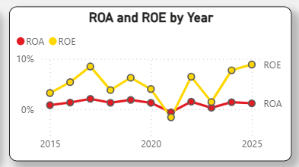
VIC DASHBOARD
Design Strategy
TRENDS
Efficiency Comparison: Tracks Return on Assets (Red Line) and Return on Equity (Yellow Line) to measure management effectiveness.
Leverage Insights: The consistent gap where ROE remains higher than ROA indicates the strategic use of financial leverage to boost shareholder returns.
Recovery Signal: Both metrics show a sharp decline in 2021 but demonstrate a strong recovery trend heading into 2025.

Slide 15
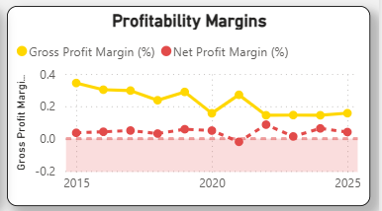
VIC DASHBOARD
Design Strategy
TRENDS
Evaluate Efficiency: To compare core production returns (Gross) against final bottom-line profitability (Net) across Vingroup’s diverse sectors.
Monitor Stability: To track financial health and cost impacts during capital-intensive industrial transitions, specifically identifying recovery periods.

Slide 16
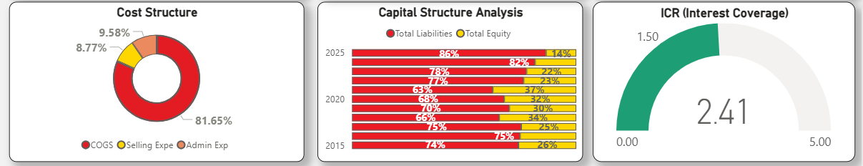
VIC DASHBOARD
Design Strategy
STRUCTURE

Slide 17
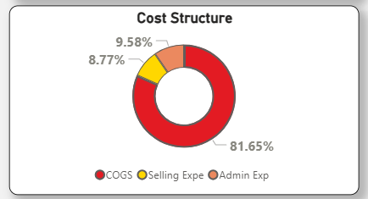
VIC DASHBOARD
Design Strategy
STRUCTURE
Purpose: To identify key cost drivers for optimizing operational and production efficiency.
Variables: COGS, Selling Expe, Admin Exp

Slide 18
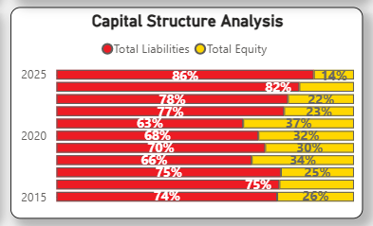
VIC DASHBOARD
Design Strategy
STRUCTURE
Purpose: To monitor financial leverage trends and the balance between debt and shareholder equity over time.
Variables: Total Liabilities, Total Equity, Year

Slide 19
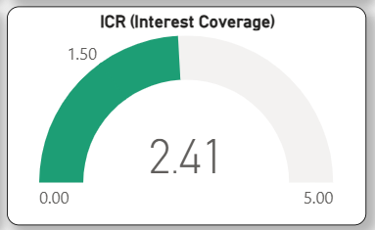
VIC DASHBOARD
Design Strategy
STRUCTURE
Purpose: To measure financial safety and the ability to service debt interests using operating profits.
Strategic Purpose: Acts as a solvency sensor to ensure the company can comfortably service its debt interests using current operating profits.
Variables: Operating Profit, Profit Before Tax (used to derive Interest Expense), and the ICR measure.

Slide 20
VIC DASHBOARD
Introduction

